Slide 1
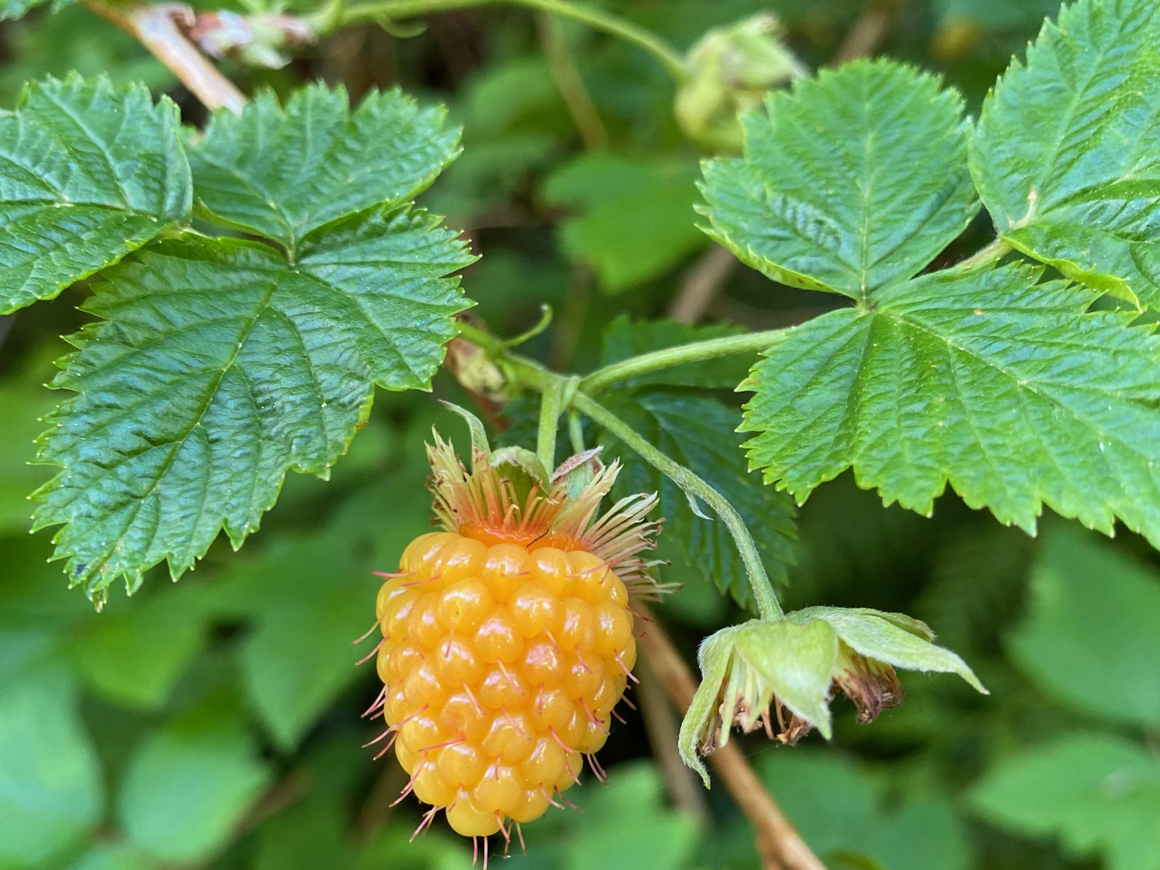
NAMES OF PLANT or ANIMAL
Salmonberry
Rubus spectabilis
Indigenous name
ELILE IȽĆ (in SENĆOŦEN; WSAANAC nation)

Slide 2
Primary Uses
(e.g. food, medicine, materials, spiritual)
Food, Medicine
Salmonberry (Example)
Knowledge and Uses
Salmonberry shoots can be peeled and eaten raw or steamed, as a first spring food.
Salmonberry bark can be used to treat cuts.
Medicinal tea is made from the stems.
And, of course, the berries are delicious! Make sure to harvest responsibly and leave most for the wildlife.
Salmonberry patches were managed by burning them in the fall which helps new shoots to grow.
The Swainson’s thrush is also called the Salmonberry bird. There is a story about how his song helps to ripen the salmonberries.
Description
A thorny shrub related to raspberry that grows up to 3 m tall with pink flowers. It produces delicious yellow, orange, and red berries in the summer. It grows in moist forests and along streams. It’s common at NAME of local place. Include other details such as if it is toxic, how to tell it apart from other similar species.
Relationships (e.g. Conservation notes, harvest guidelines, ecological connections or threats)
Rufous hummingbirds rely on salmonberry flower nectar in the early spring during their migration, and many animals eat the fruits. Invasive Himalayan blackberry can take over salmonberry habitat and doesn’t support as much wildlife because it flowers and produces fruit later in the summer, after many birds (who need energy from the fruit) are done nesting.

