Slide 1




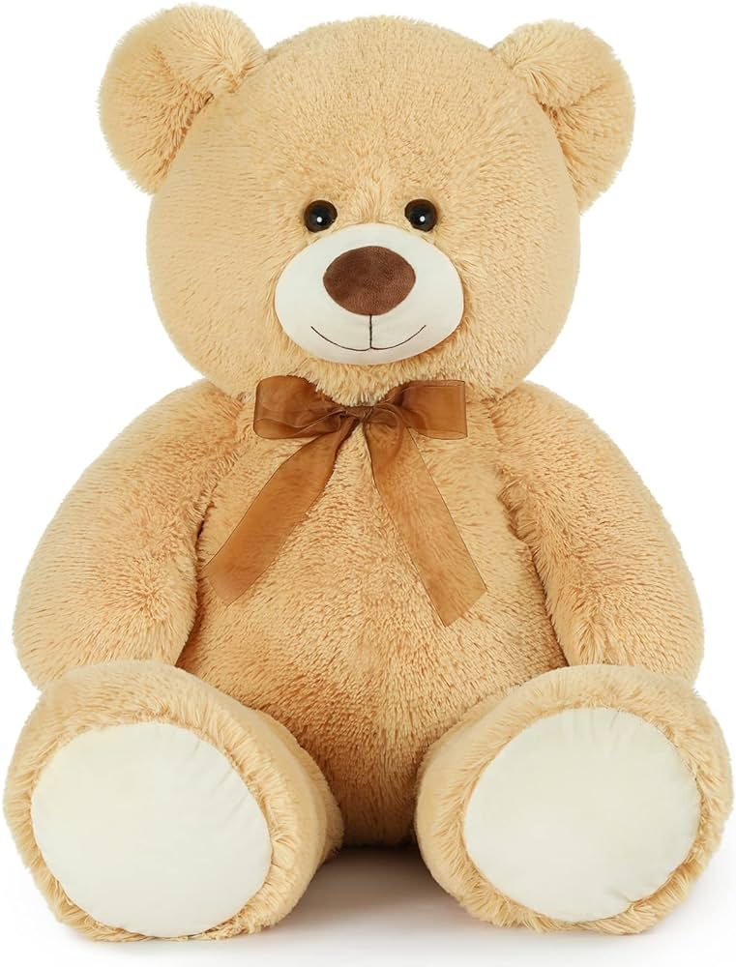





@teddy123
Location
Title!
Put info about yourself here.
#hashtags
Date of post
Comments
@bunny4: Hi bestie!

Slide 2
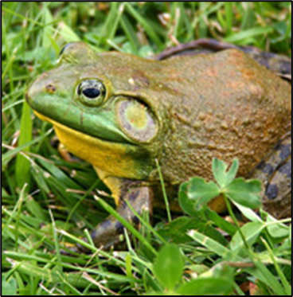
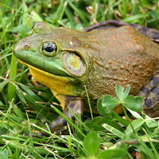
@thegreenmachine24
Beaver Lake, BC
I’m hungry, again!
Hey there! I’m Brendan the Bullfrog. Just started this insta account to show all of you tiny creatures what it’s like to be the biggest frog in the pond. Get ready to be invaded by me and my family! Lol #invasive4life #watchout #yumyum
April 14, 2025
Comments:
@justababyduck: Ugh, these selfish frogs are everywhere. Do you even know how much you’re hurting my home? #neverforgetheduckmassacreof2023

Slide 3
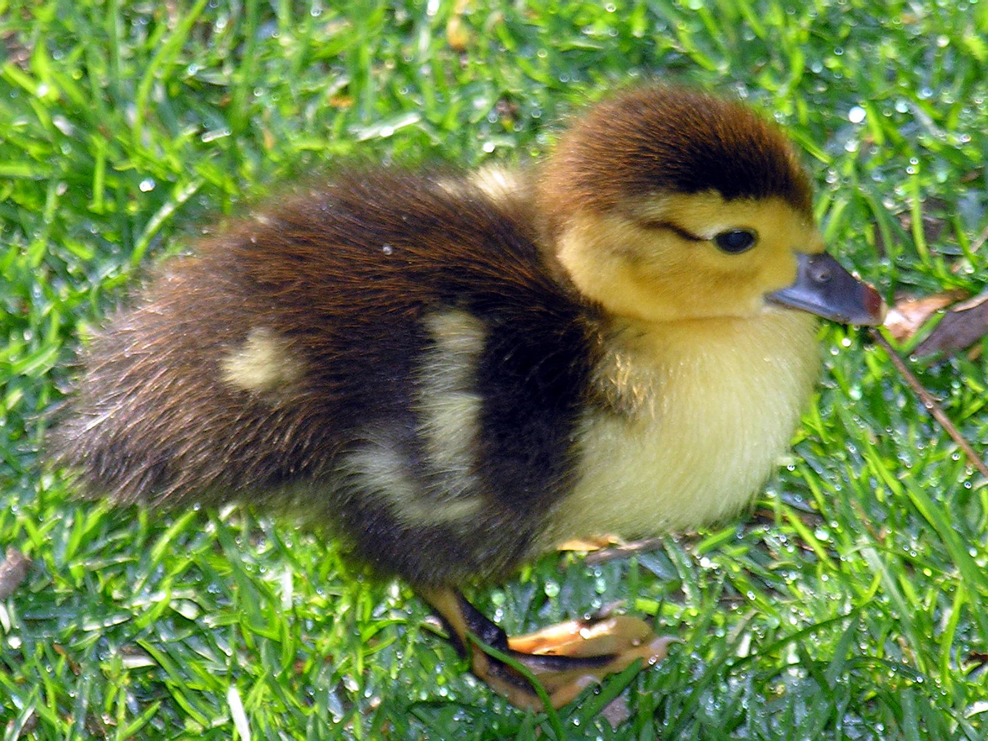
@thegreenmachine24
Elk Lake, BC
I’m literally the coolest ever
Do you guys remember @justababyduck who wrote that hate comment? Guess who ate her! It was me! Yummy snack for ya boi. #ducksaresoover #feathersinmytumtum
April 15, 2024
Comments:
@mamaduck: I’ll never forgive you @thegreenmachine24. Your tadpoles are a goner.#missyoubaby
@pollywog44: Mamaduck, I feel your pain. My dad seriously meant no harm. He’s just doing what he does best: Eat. A lot.

